Slide 1
Java: A Beginner’s Guide
Chapter 15: Applets, Events, and Miscellaneous Topics

Slide 2
Key skills and concepts
Understand applet basics
Know the applet architecture
Create an applet skeleton
Initialize and terminate applets
Repaint applets
Output to the status window
Pass parameters to an applet
Know the Applet class
Understand the delegation event model
Use the delegation event model
Know the remaining Java keywords

Slide 3
Applet basics
Small programs designed for transmission over the Internet
Run within a browser
Secure way to dynamically download and execute programs over the Web.
Two basic varieties:
Based on Abstract Windows Toolkit (AWT)
Based on Swing

Slide 4
Applet basics
// Simple AWT-based applet
Import java.awt.*;
Import java.applet.*;
public class SimpleApplet extends Applet {
// Paint method redisplays the screen
public void paint(Graphics g)
g.drawString(“Java applets are easy!”,20,20)
}
}

Slide 5
The applet architecture
Graphical User Interface (GUI) based program.
Event driven
Waits for an event to occur
May responds to different events
User initiates interaction with an applet
User initiates events in any sequence
Applets contain many controls such as buttons, check boxes, text areas which may have events.

Slide 6
A complete applet skeleton
Applets contain several methods
init() – performs initialization operations
start() – stars or resumes execution
stop() – suspends execution
destroy() – performs shutdown operations
paint() – redisplays the contents of the window

Slide 7
applet initialization and termination
Initialization calls
init()
start()
paint()
Termination calls
stop()
destroy()

Slide 8
requesting repainting
Window only gets updated when paint() is called.
Fundamental constraint is an applet must quickly return control to the run-time system.
repaint() method updates the windows
Part of the AWT’s Component class
Calls paint()
Can update the entire window or a portion
void repaint()
void repaint(int left, int top, int width, int height)

Slide 9
requesting repainting
update() method
Part of the Component class
Applies only to AWT-based applets
Called when your applet requests a portion of the screen to be redrawn.
Default versions calls paint()
You can override update()

Slide 10
using the status window
Displayed at the bottom of the window
Place where you can communicate to the user.
void showStatus(string message)
// Called when AWT-based applet is windows must be restored.
public void paint(Graphics g) {
// Sets font
Font f = new Font("Comic Sans MS", Font.PLAIN, 20);
g.setFont(f);
g.drawString("Java is Fun!", 50, 30);
showStatus("Painting the applet");
}

Slide 11
Passing Parameters to applets
You can pass data from tags in a Web page.
Use the param attribute of the applet tag.
<applet code=“programName”>
<param name=paramName1 value=“value1”>
<param name=paramName2 value=“value2”>
<param name=paramName3 value=“value3”>
</applet>

Slide 12
Passing Parameters to applets
public class GetParams extends Applet {
// Parameters declarations
String author;
String programName;
int version;
// Called after init() or whenever apples is restarted.
public void start() {
// Get the parameters
author = getParameter("author");
if(author==null) author = "No author";
programName = getParameter(“programName");
if(programName==null) programName = "No program name.";
String strVer = getParameter("version");
try {
if (strVer != null) version = Integer.parseInt(strVer);
else version = 0;
}
catch (Exception err) { version = -1; }
}
// Called when AWT-based applet is windows must be restored.
public void paint(Graphics g) {
// Redisplays the windows contents
g.drawString(author, 10, 20);
g.drawString(programName, 10, 40);
g.drawString("Version: " + version, 10, 60);
}
}
In your web page:
<applet code=“GetParams”>
<param name=author value = “Gary”>
<param name=programName value=“GetParams”>
<param name=version value=“1”>
</applet>
Note: names must match between name=? statement and the getParameter(“?”) statement.

Slide 13
The applet class
Applet class inherits from the AWT superclasses
Component
Container
Panel
See table 15-1 on page 526-527 for list of methods.

Slide 14
Event handling
GUI programs are event driven
Utilized the delegation event model
Standard and consistent mechanisms to generate and process events.
A source generates an event and sends it to a listener.
Logic that processes events are separate from the logic the generates the events.

Slide 15
Events
An object the describes a state change in source.
Press a button
Typing text
Clicking a mouse

Slide 16
Event sources
An object that generates an event.
A source may generate several types of events.
A source must register a listener in order for the listener to receive notifications about an event.
Add a listener:
public void addTypeListener(TypeListener el)
Remove a listener:
public void removeTypeListener(TypeListener el)

Slide 17
Event sources
Listener Examples
addKeyListener()
addMouseListener()
addMouseMotionListener()
addItemListener()
addActionListener()

Slide 18
Event listeners
An object that is notified when an event occurs.
It must first be registered.
It must implement methods to receive and process the notifications.
Defined as a set of interfaces

Slide 19
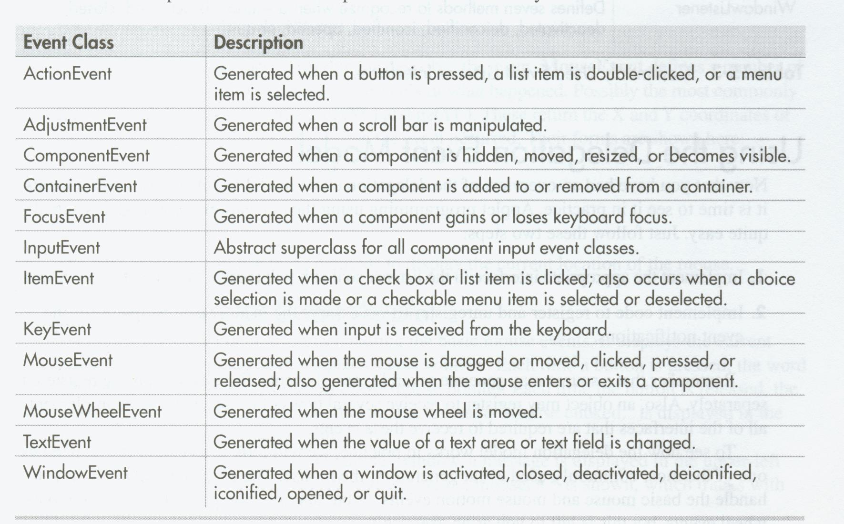
Event Listener Interfaces

Slide 20
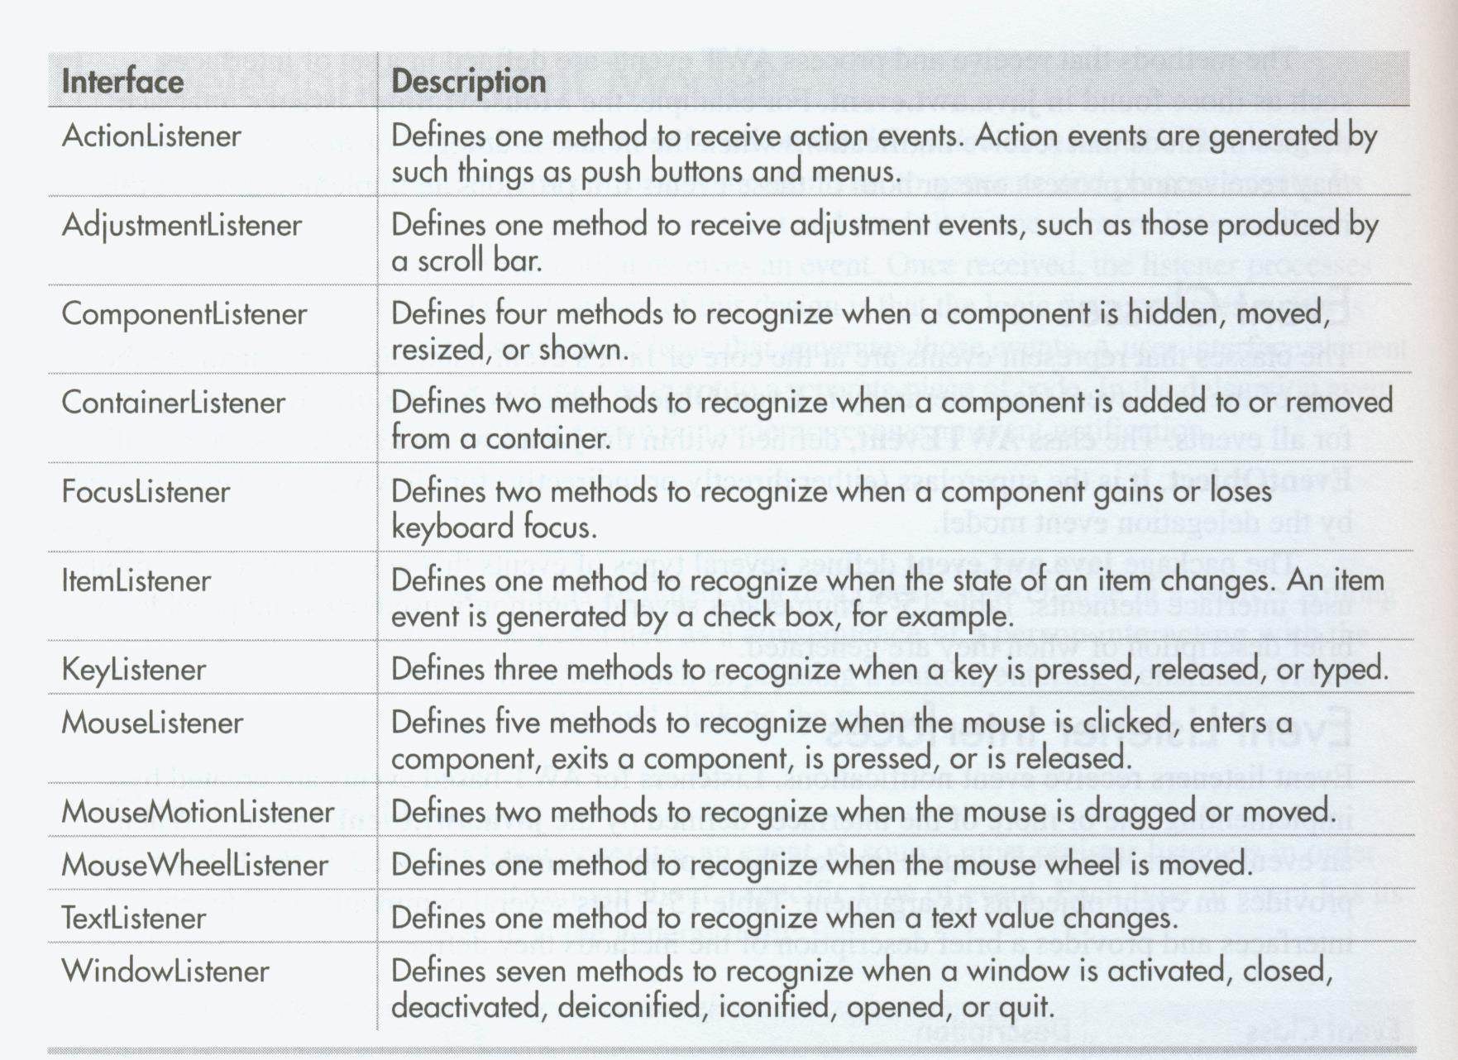
Event Listener Interfaces

Slide 21
Using the delegation event model
Two basic steps
Implement the appropriate interface in the listener
Implement code to register and unregister (if necessary) the listener

Slide 22
More Java keywords
transient
volatile
instanceof
native
strictfp
assert

Slide 23
transient and volatile modifiers
Handles specialized situations
A transient field is one that does not affect the persisted state of an object
The volatile modifier tells the compiler a variable can be changed unexpectedly by other parts of your program.
Use in multithreaded applications where two or more threads share the same variable.

Slide 24
instanceof
Tells you the type of an object at run time.
Format: objectRef instanceof type
return true of objecRef is of type

Slide 25
strictfp
As of Java 2, floating-point computation model was relaxed slightly.
Does not require truncation of certain intermediate values during a computation
strictfp insures floating-point calculations takes place preceisly as pre Java 2 did.
Can be applied to a class, method, or interface.

Slide 26
assert
Use during program development to create an assertion.
An assertion is a condition that is expected to be true during execution of a program.
Not usually used for released code.
Formats:
assert condition;
assert condition : expresion

Slide 27
assert
If condition is false, an AssertionError is thrown.
The expression value is passed to the AssertionError constructor for the 2nd form.
You must enable assertion handling at run time
java –ea Sample

Slide 28
Native methods
Used rarely
Use to call a method written in another language
You declare a native method using the native keyword
public native returnType methodName();
You must then link the method to your Java code.

